Slide 1

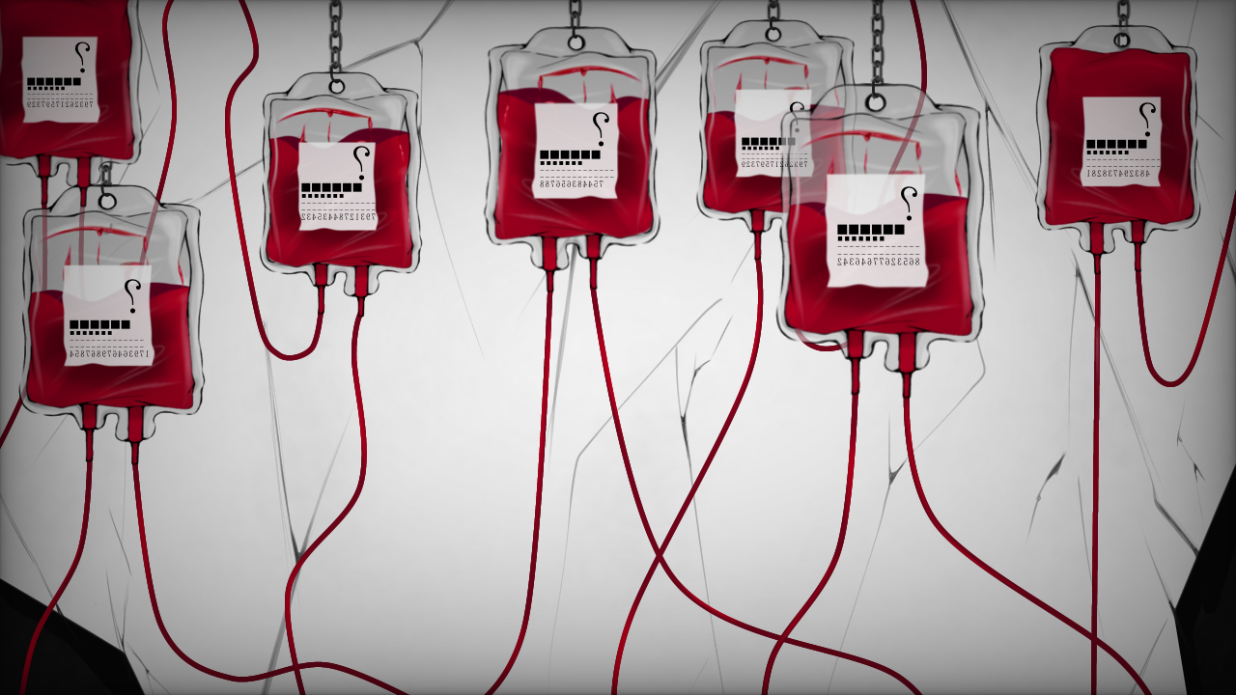
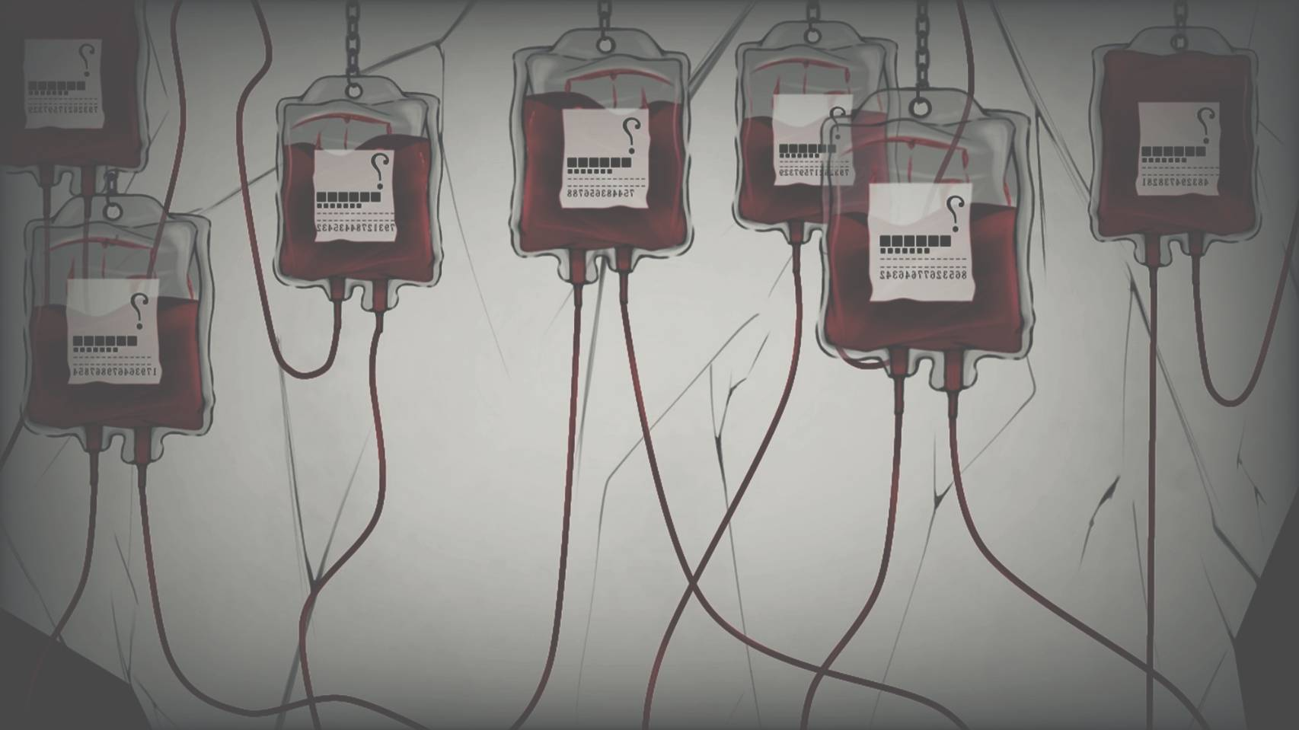
冒險故事

Slide 2
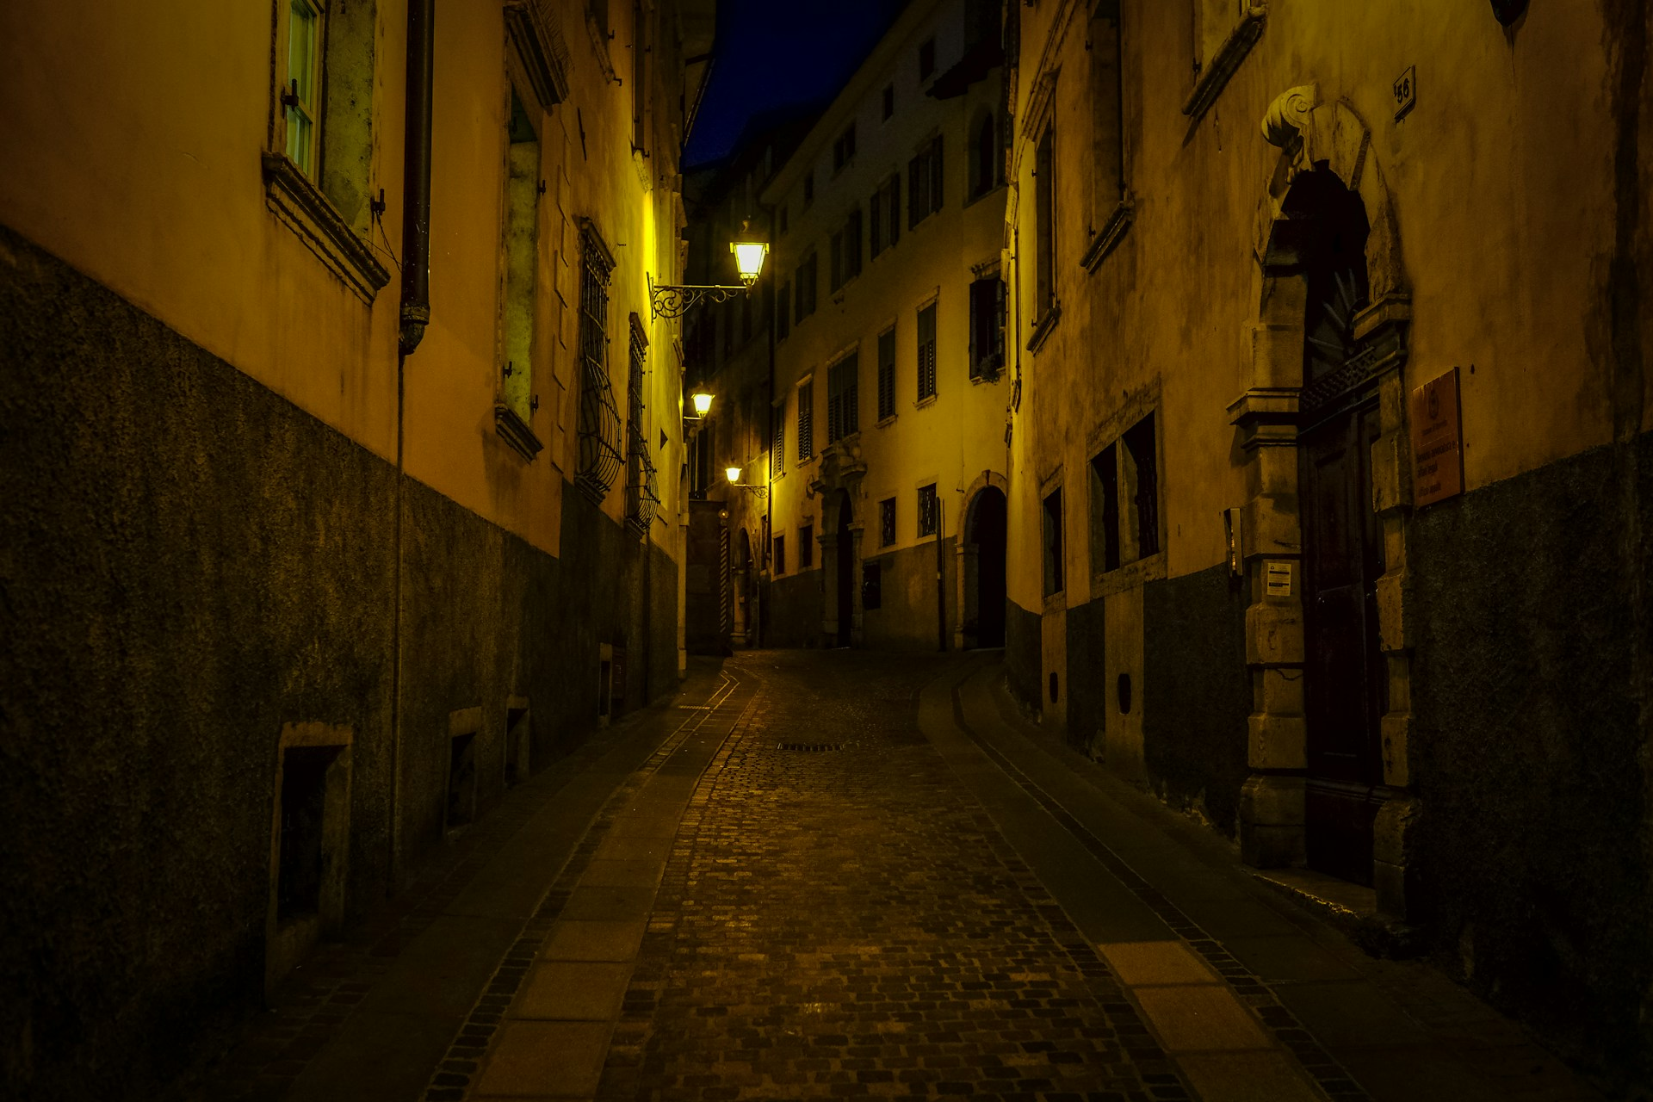

目標
Notes:
https://unsplash.com/photos/gray-pavement-road-in-between-residential-building-MEr1rGSa38k

Slide 3
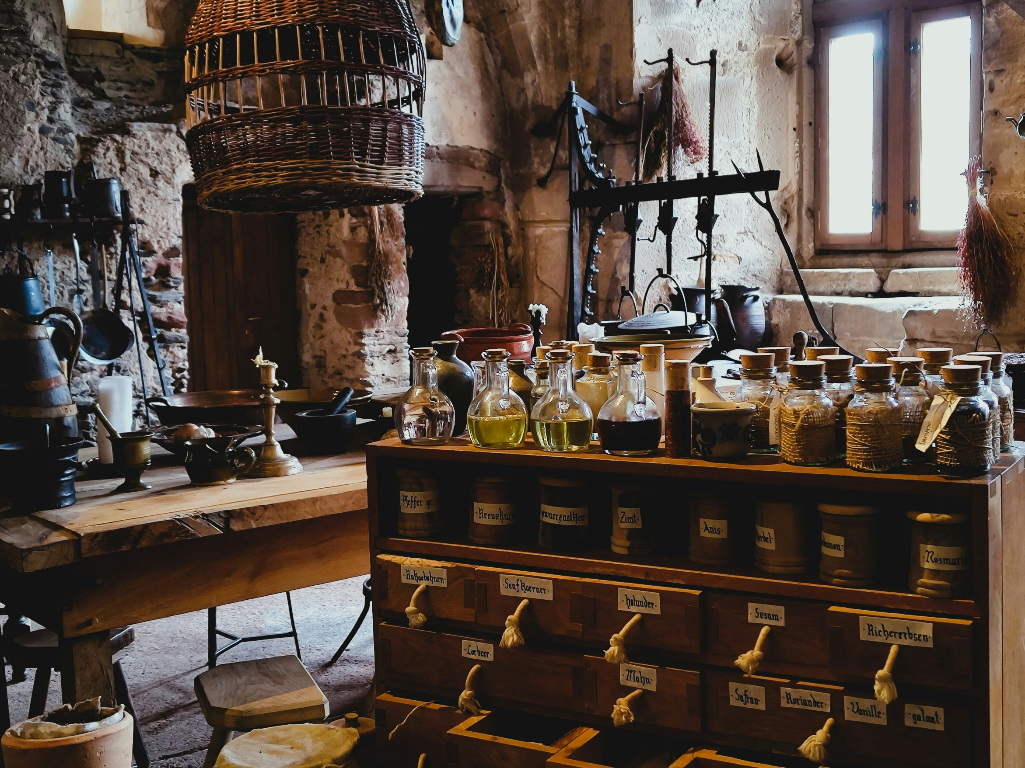
阻礙
Notes:
https://unsplash.com/photos/a-room-with-a-bunch-of-bottles-on-a-table-mIsi2l0p9jA

Slide 4
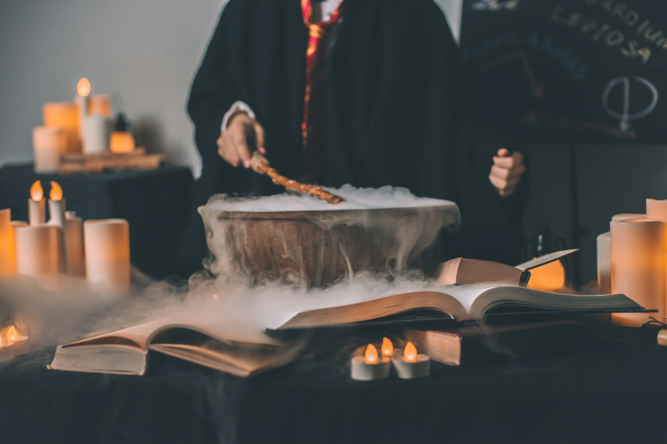
努力
Notes:
https://unsplash.com/photos/person-holding-wand-on-top-of-bowl-3n7DdlkMfEg

Slide 5
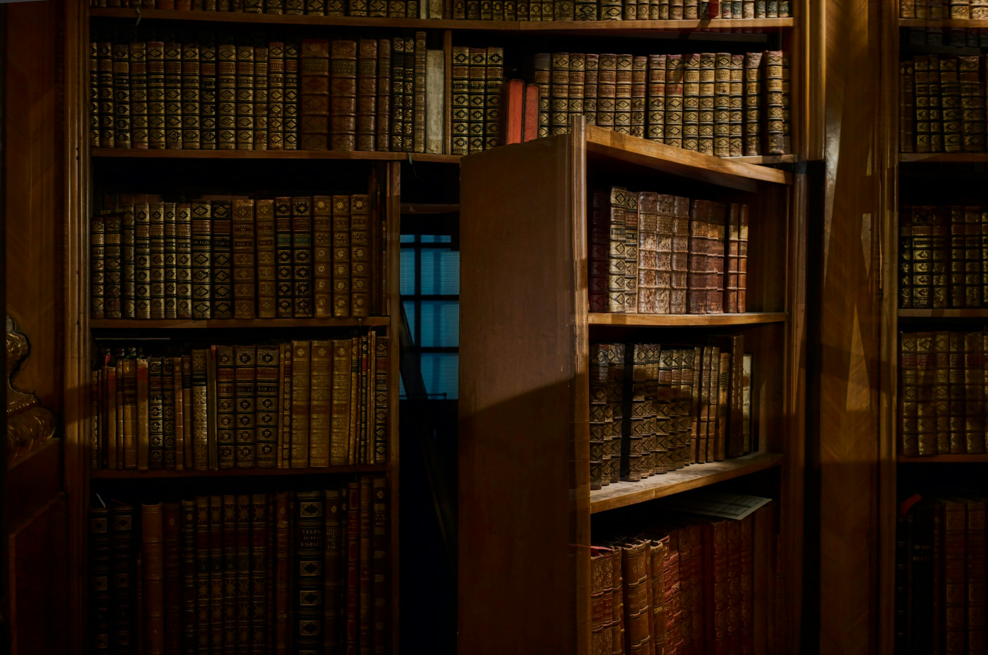
結果
Notes:
https://unsplash.com/photos/opened-secret-door-inside-library-HK8IoD-5zpg

Slide 6
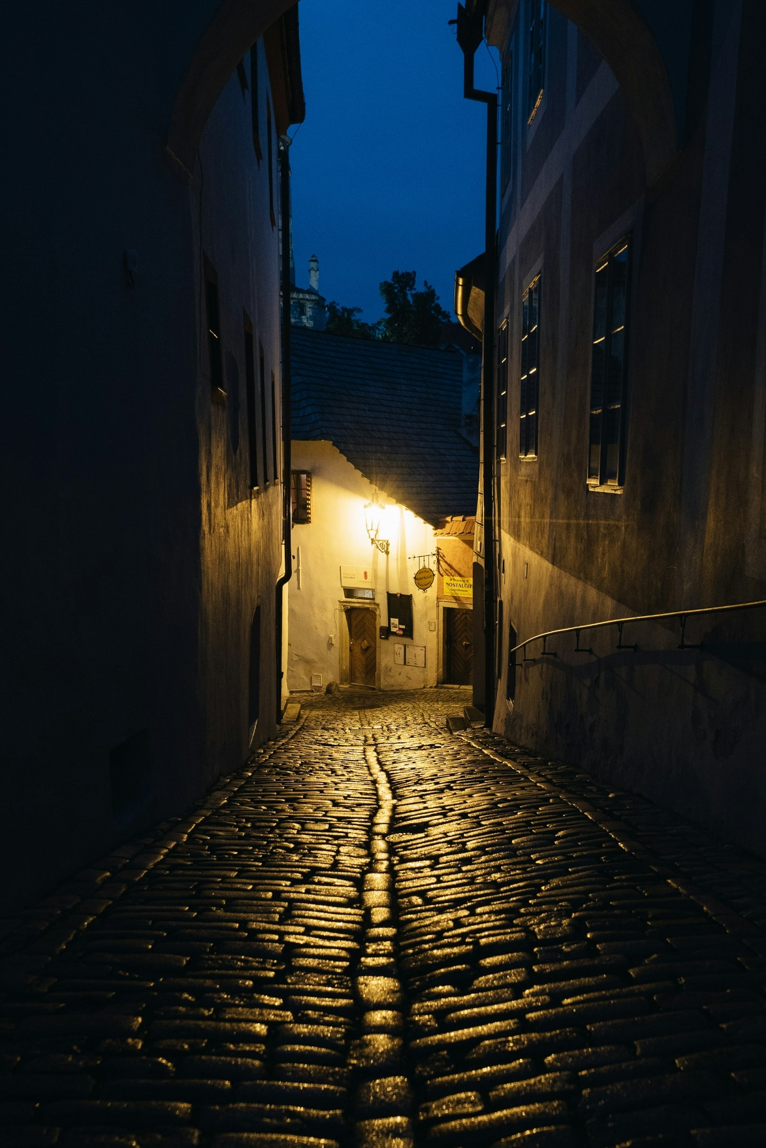
意外
Notes:
https://unsplash.com/photos/a-cobblestone-street-at-night-with-a-light-on-CznBsnwCx9Y

Slide 7
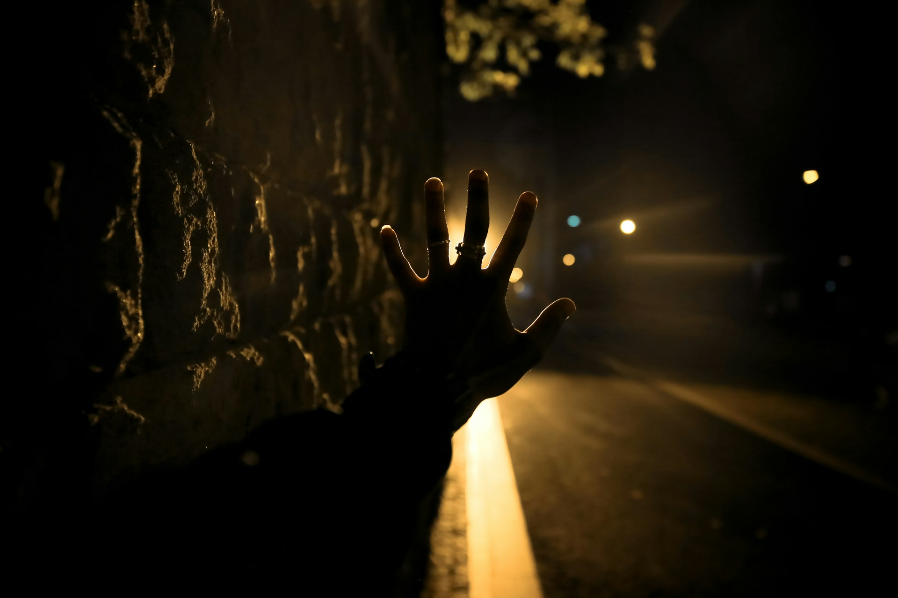
轉彎
Notes:
https://unsplash.com/photos/person-signing-stop-near-road-during-night-time-dj5eifvyVfE

Slide 8
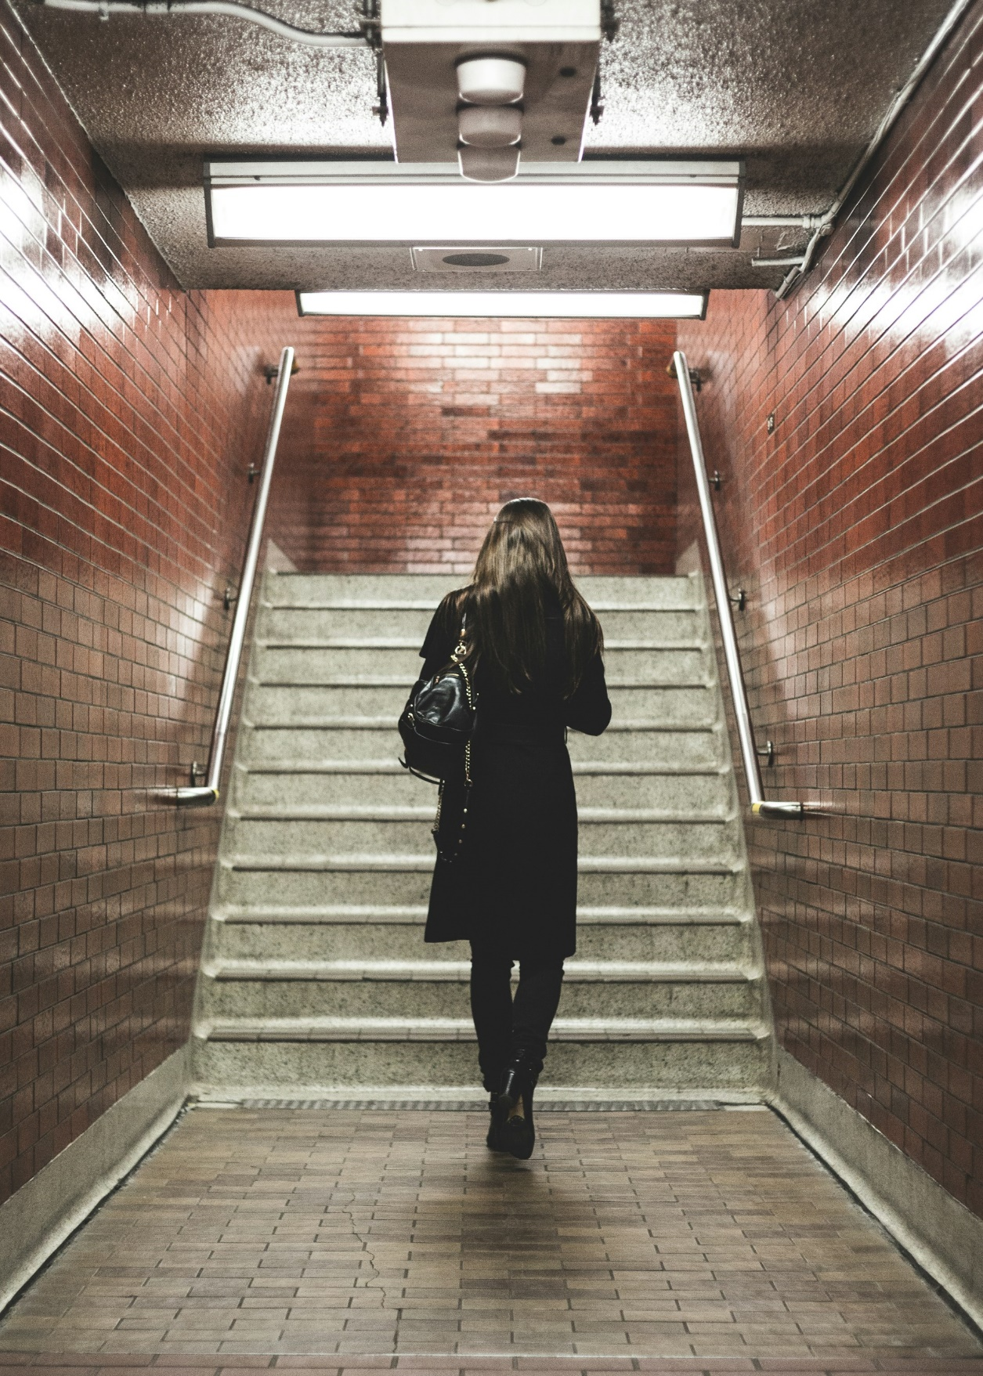
結局
Notes:
https://unsplash.com/photos/woman-walking-near-staircase-Mg9xdh3keeo

Slide 9
感謝聆聽

